Slide 1

Data Visualization Accessibility
Workshop, Visualizing Knowledge, Jun 2023
axle-lab.com
Thinking about data visualization for people with disabilities.
Frank Elavsky, PhD student at Carnegie Mellon University

Slide 2
Today’s agenda
Part 1: 1 hour + 10 minute break
Important concepts in accessibility and disability
Cool emerging work, Q/A, and sharing
Part 2: 50 minutes + 10 minute break
How to catch accessibility barriers in a visualization
Part 3: 50 minutes
Hands-on exploration of different kinds of data representation

Slide 3
Who am I? A data visualization + accessibility researcher and engineer
Research: Carnegie Mellon and Apple.
Organize: DataVizA11y.
Contribute: W3C’s ARIA Working Group as an invited expert.
Create: Tools for designers and engineers who want to make accessible visualizations.

Slide 4
Creators
4

Slide 5
Creators
Tools
5

Slide 6
Creators
Tools
Things
6

Slide 7
Creators
Tools
Things
Future Things
7

Slide 8
But how much of this is inaccessible?
Creators
Tools
Things
Future Things
8

Slide 9
97-99.9%
Creators
Tools
Things
Future Things
Source: World Wide Web Consortium. “The WebAIM Million.”
9

Slide 10
Dreaming of ideals
Creators
Tools
Things
Future Things
10
Notes:
Common, the way most people do this work

Slide 11
The knowledgeable “specialist” intervenes
Creators
Tools
Things
Future Things
11
Notes:
Common, the way most people do this work

Slide 12
We change our systems, laws, and environments
Creators
Tools
Things
Future Things
12

Slide 13
We give creators better tools
Creators
Tools
Things
Future Things
13

Slide 14
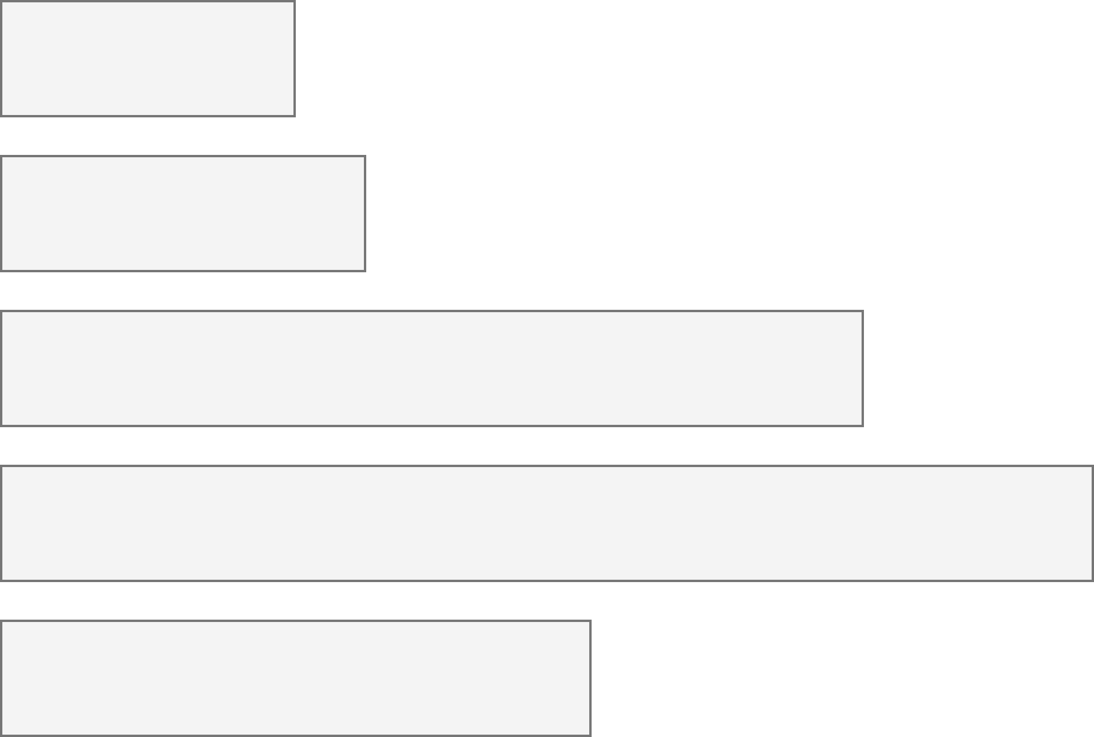
26% of people living in the United States self-report living with a disability that affects their daily life.
4.1%
Color Vision Deficiency
4.5%
Blindness, Low Vision
10.8%
Cognitive, Neurological
13.7%
Motor, Dexterity
7.4%
Vestibular, Motion
Source: Okoro et al. “Prevalence of Disabilities and Health Care Access by Disability Status and Type Among Adults”
Notes:
But how do designers, developers, and creators of visualizations know whether something they’ve made is accessible or not for people with disabilities?

Slide 15
Every area of disability affects data visualization work.
Color Vision Deficiency
Visual design
4.1%
Non-visual design
4.5%
Blindness, Low Vision
Narrative design, statistics, storytelling
10.8%
Cognitive, Neurological
13.7%
Motor, Dexterity
Interaction design, device considerations, performance
7.4%
Vestibular, Motion
Animation, transitions
Notes:
But how do designers, developers, and creators of visualizations know whether something they’ve made is accessible or not for people with disabilities?

Slide 16
What you will learn today
What is accessibility?
What are the social and medical models of disability?
What are “ability assumptions”?
What is “situational” disability or impairment?
What are some recent advancements?

Slide 17
Discuss: What is accessibility?
Bonus discussion:
What is “Inclusive Design” and how is it different from accessibility?

Slide 18
Accessibility (some working definitions):
1. The qualities that make an experience open or usable to all.
2. The qualities that make an experience open or usable specifically for people with disabilities.

Slide 19
26% are disabled. Now what?
4.1%
Color Vision Deficiency
4.5%
Blindness, Low Vision
10.8%
Cognitive, Neurological
13.7%
Motor, Dexterity
7.4%
Vestibular, Motion
Source: Okoro et al. “Prevalence of Disabilities and Health Care Access by Disability Status and Type Among Adults”
Introduction - Example - Design - Evaluation - Results - Future Work
Notes:
But how do designers, developers, and creators of visualizations know whether something they’ve made is accessible or not for people with disabilities?

Slide 20
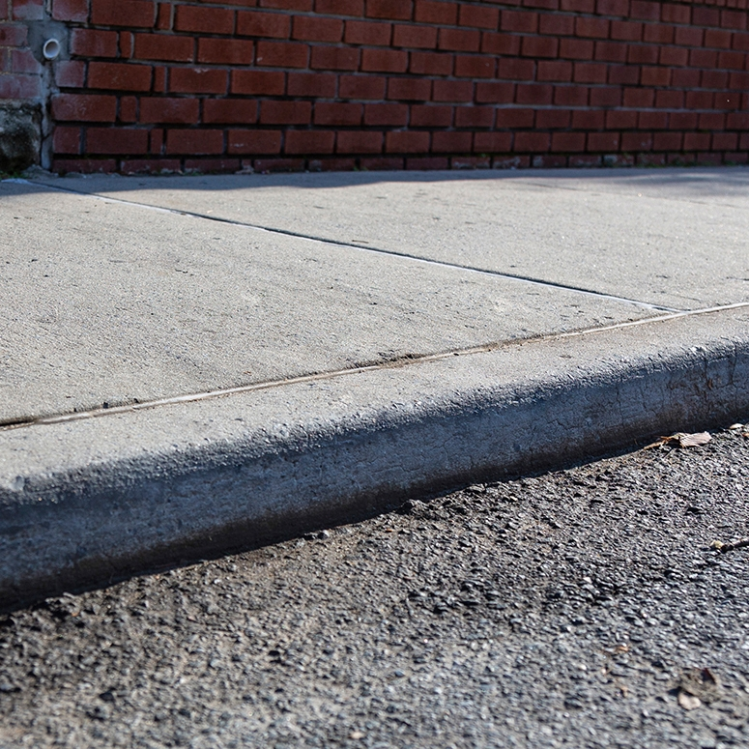
Concept: social vs medical models of disability
a “curb”

Slide 21
What do we do about curbs in our cities?

Slide 22
Medical model: the body is the cause of disability (according to normative standards).

Slide 23
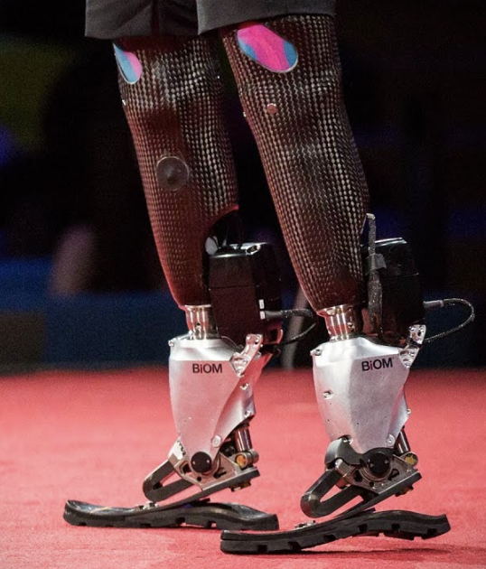
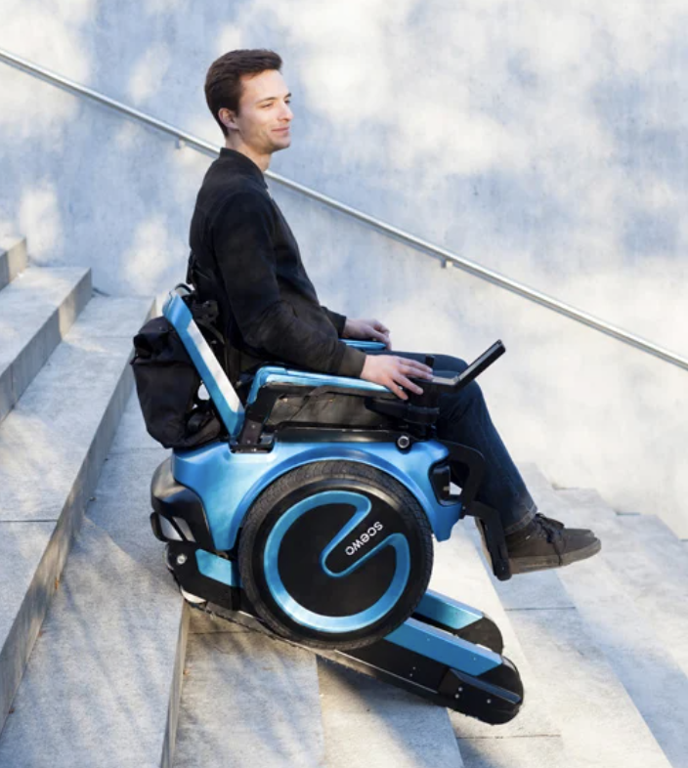
Medical model: augment or “cure” the body.

Slide 24
Social model: The curb is the source of disability (a “barrier” to access).

Slide 25
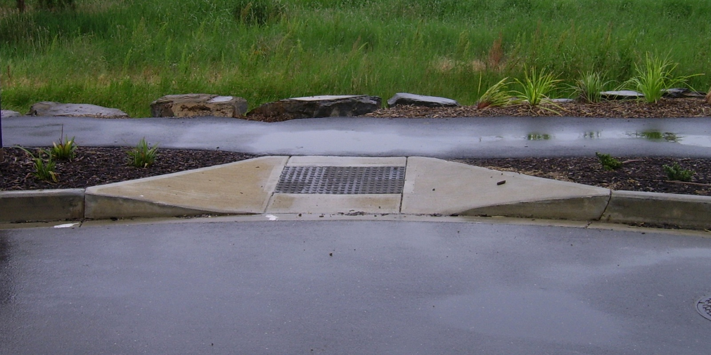
Social model: Cut the curb.

Slide 26
Discuss: Why do people do this work?

Slide 27

Access is a human right
Accessibility is an internationally recognized human right.
It is the morally and ethically correct thing to do.
https://www.un.org/development/desa/disabilities/convention-on-the-rights-of-persons-with-disabilities/article-9-accessibility.html
https://www.un.org/development/desa/disabilities/convention-on-the-rights-of-persons-with-disabilities/article-10-right-to-life.html

Slide 28
It is expensive to exclude accessibility

Slide 29
15% of time spent on accessibility…
… for 26% of all people
It is expensive to exclude accessibility

Slide 30
Fixing inaccessibility takes 1.5 – 10x more time if done after something is built.

Slide 31
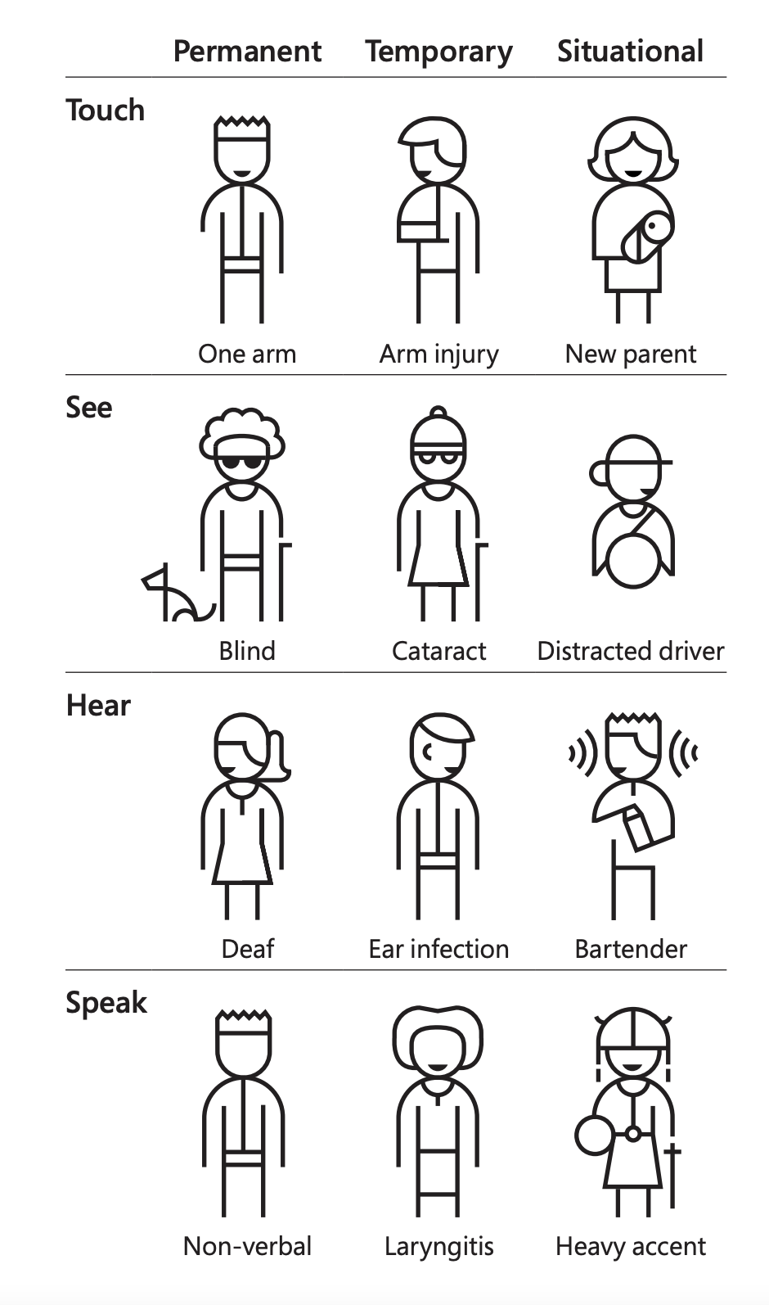
Concept: Situational Impairment “Design for One, Extend to All”
Microsoft’s Inclusive Design 101 Toolkit: https://download.microsoft.com/download/b/0/d/b0d4bf87-09ce-4417-8f28-d60703d672ed/inclusive_toolkit_manual_final.pdf

Slide 32
We all experience situational impairment in our daily lives. Accessibility benefits everyone!

Slide 33
Discuss: Share an example where you might be impaired in some way and how accessible technology or infrastructure helps you.

Slide 34
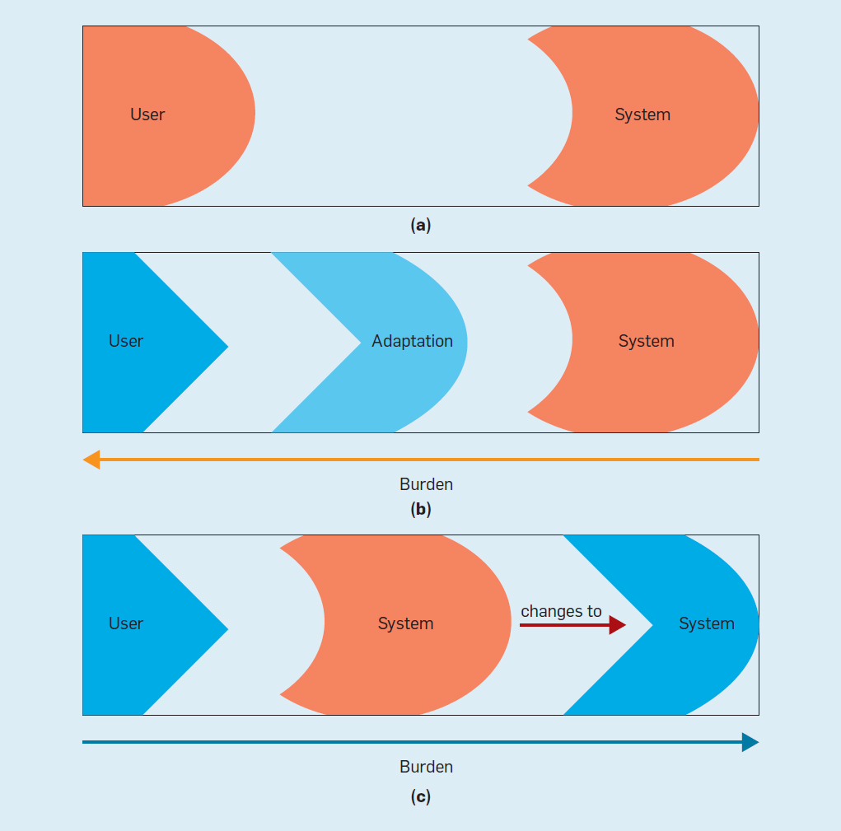
Concept: Ability Assumptions
(Wobbrock et al) https://cacm.acm.org/magazines/2018/6/228034-ability-based-design/fulltext

Slide 35
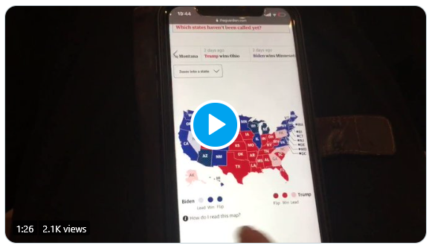
What is an inaccessible experience like?
Credit: Sarah Fossheim on twitter

Slide 36
Demo: Using a screen reader
Mac users: VoiceOver
Windows users: NVDA (requires download)

Slide 37
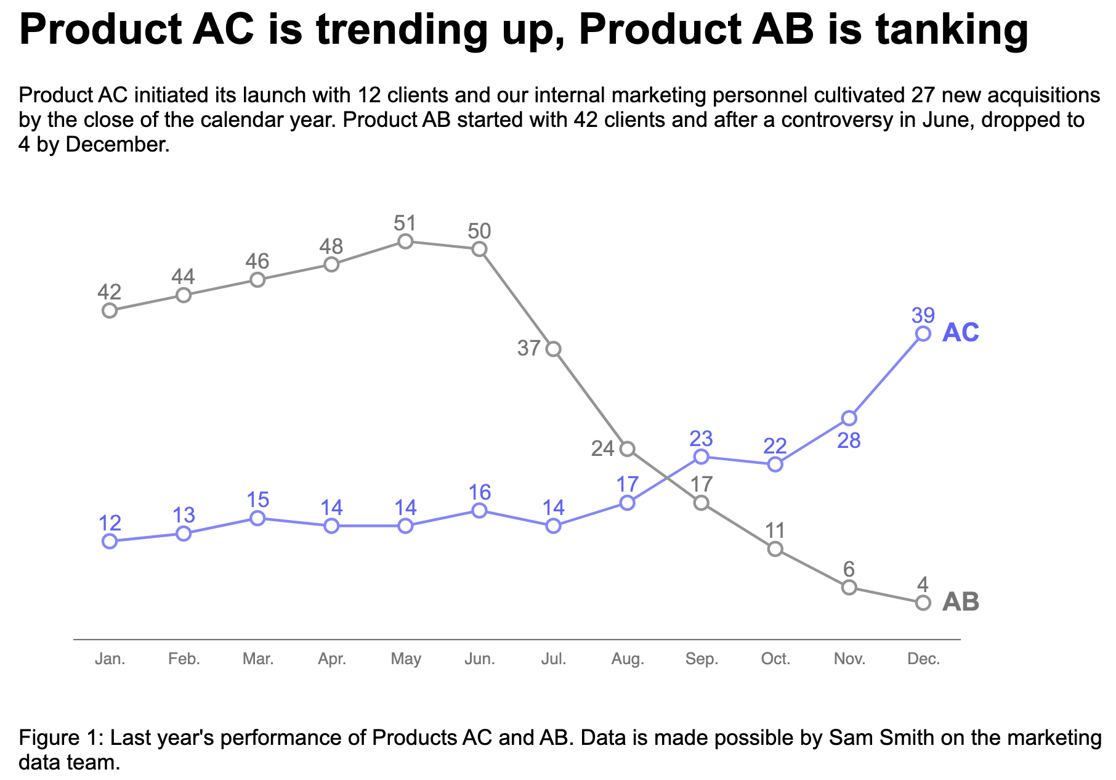
Explore: An interactive bar chart
https://frankelavsky.github.io/assessing_chart_interactivity/

Slide 38
A philosophical question: How do you know something is inaccessible?

Slide 39
Listen to people with disabilities.

Slide 40
There are a lot of ways to listen to PWD:
Actually ask them!
Find where they are already speaking
Find where they have already spoken:
Research
Blog posts
Accessibility standards

Slide 41
The fun part of this talk: The tour!
What’s happening in the broad space of science, research, data, and accessibility right now?

Slide 42
The tour
Let’s look at some cool stuff:
Nasa’s James Webb Telescope captions and image descriptions
Carni Klirs’ Sonification of NYT COVID deaths
arXiv’s Accessibility Forum 2023
Tactile Maps vs 3D Printing Tactile Graphics
Embossed graphics vs Refreshable braille displays

Slide 43
My work
Past:
Visa Chart Components, a library of charts
Chartability, a set of guidelines
Current:
(secret project)
(Demo video of my latest project?)
Refreshable data tactilization interfaces (in progress!)

Slide 44
Q/A? Does anyone want to share anything they have seen lately?

Slide 45
Part 2: How do you catch accessibility barriers in data visualizations?
(an introductory guide)

Slide 46
Remember: Listen to people with disabilities.

Slide 47
There are a lot of ways to listen to PWD:
Actually ask them!
Find where they are already speaking.
Find where they have already spoken:
Research
Blog posts
Accessibility standards

Slide 48
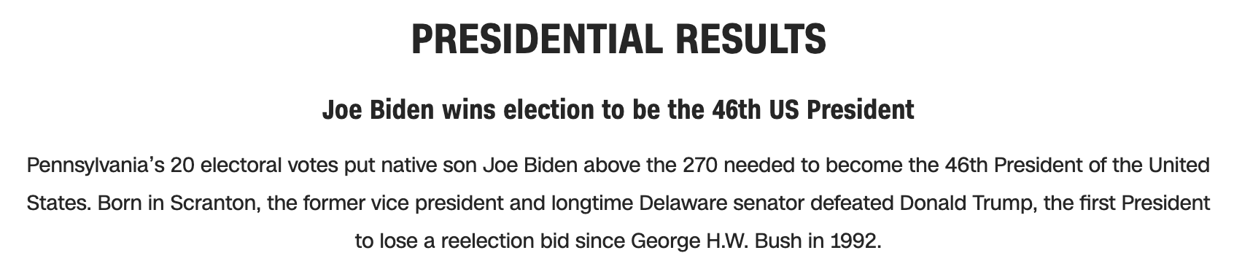
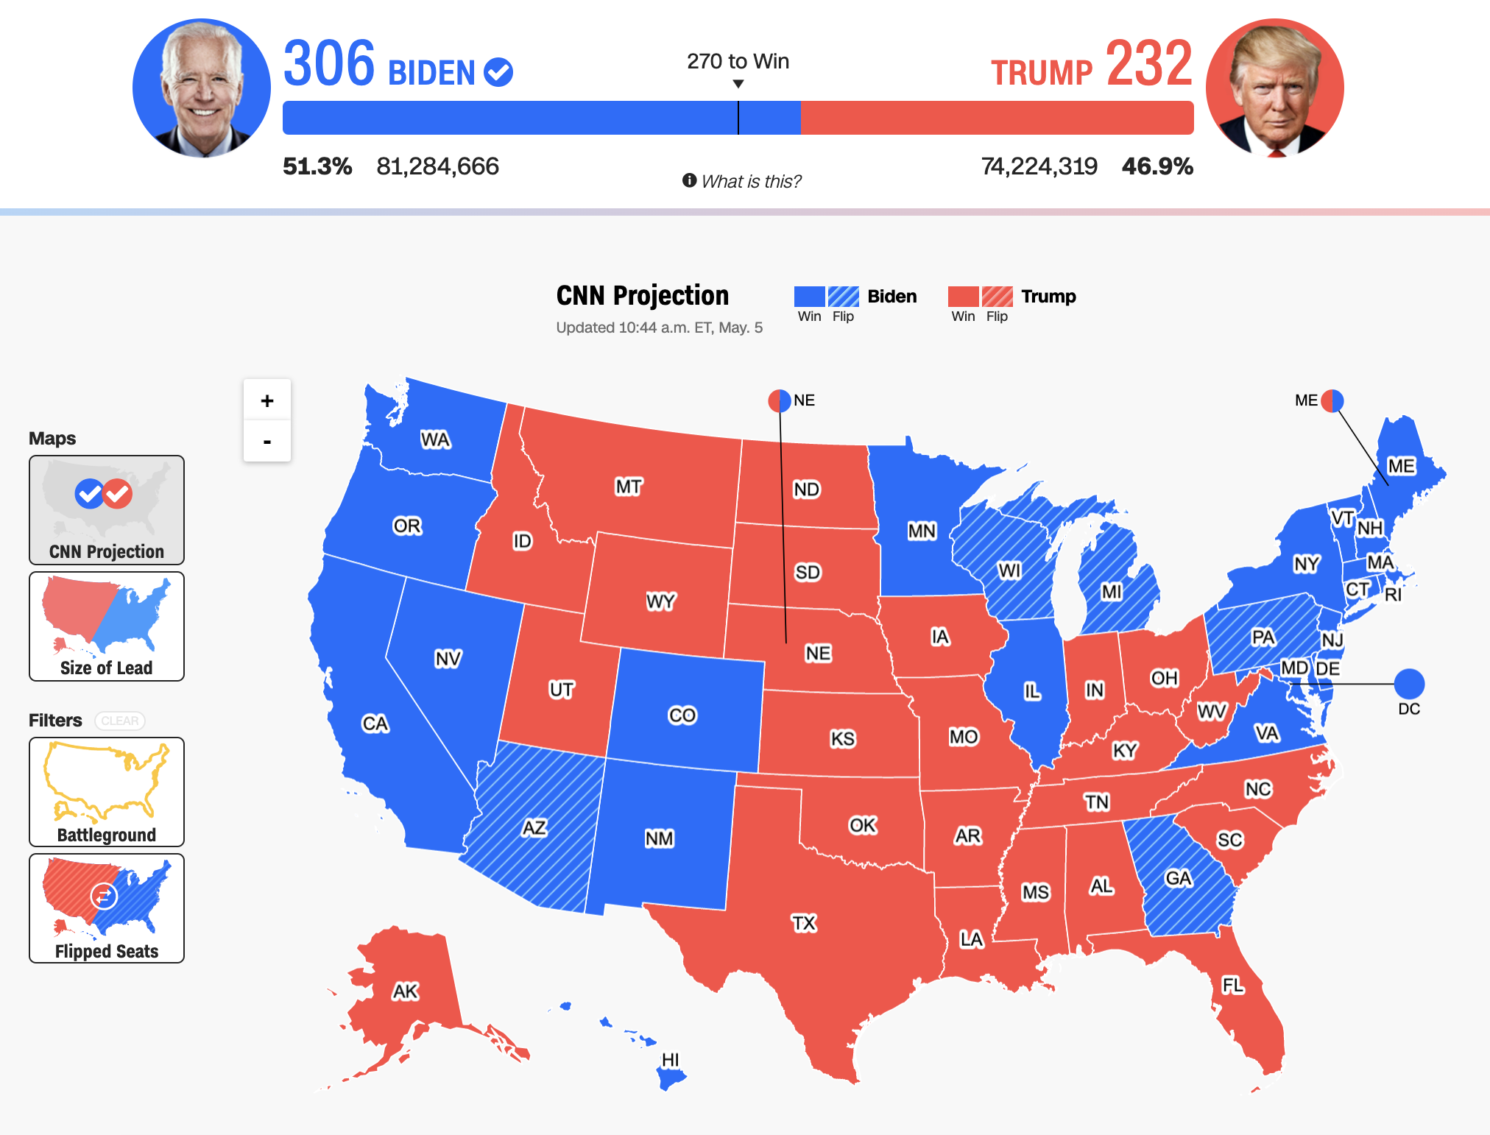
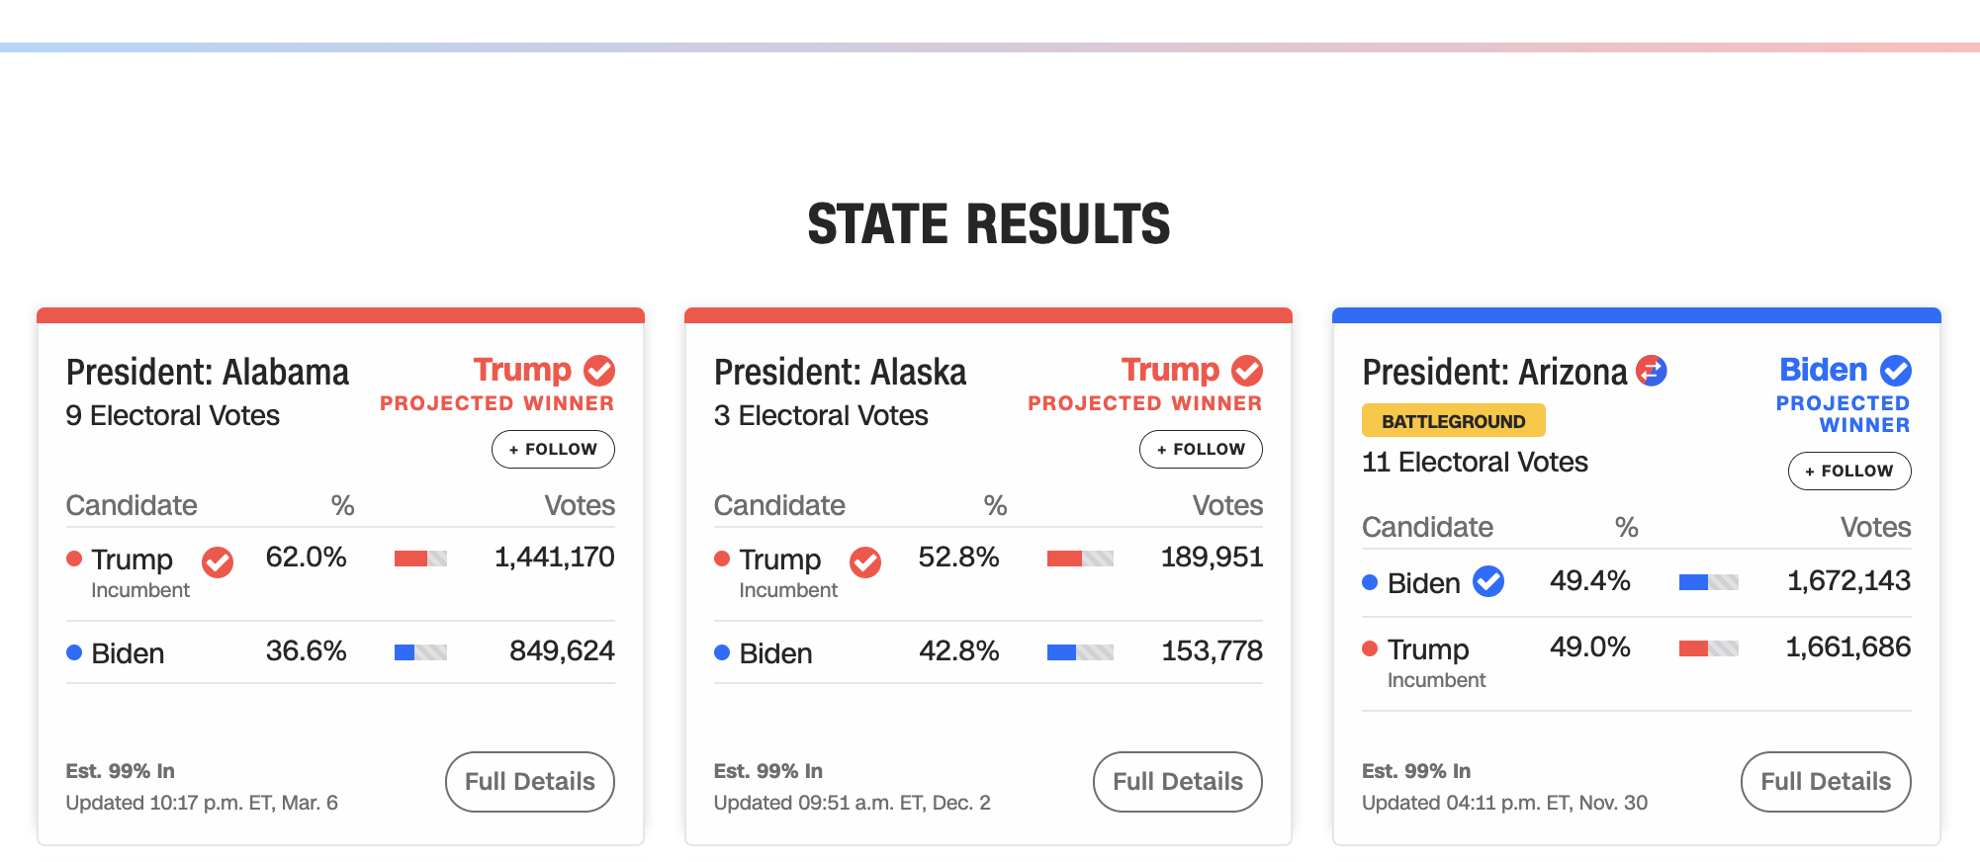

Let’s evaluate this one from CNN with Chartability.
48

Slide 49
Perceivable Failures
6 – Low contrast
57 - Content is only visual
50 - Color alone is used
1 - Meaningful elements can be distinguished
49

Slide 50
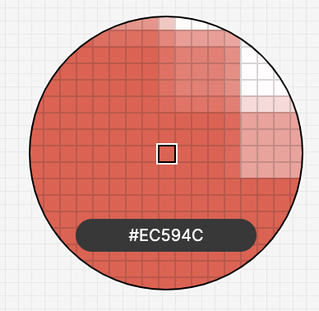
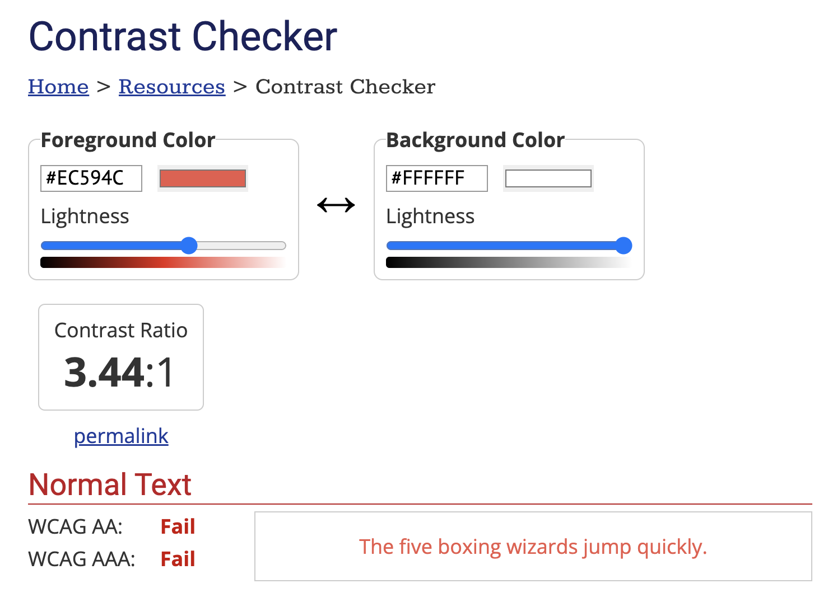

50

Slide 51
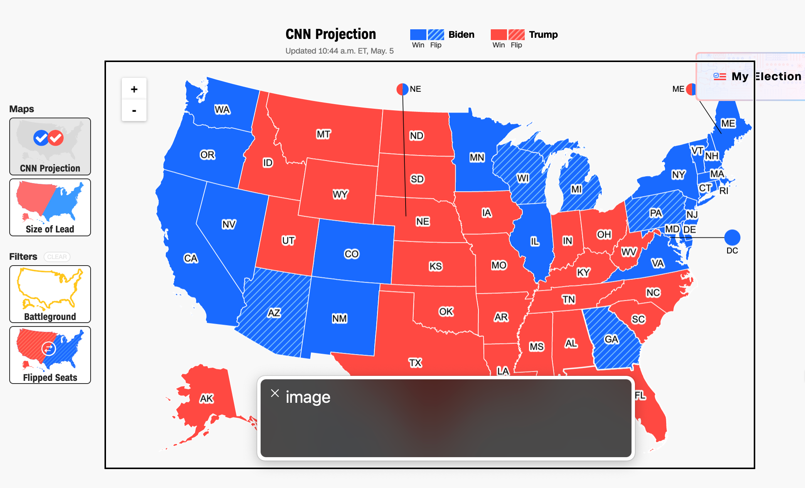
Perceivable Failures
6 – Low contrast
57 - Content is only visual
50 - Color alone is used
1 - Meaningful elements can be distinguished
51

Slide 52
Each state should announce to screen readers what state it is and who won it, not “image!”
52

Slide 53
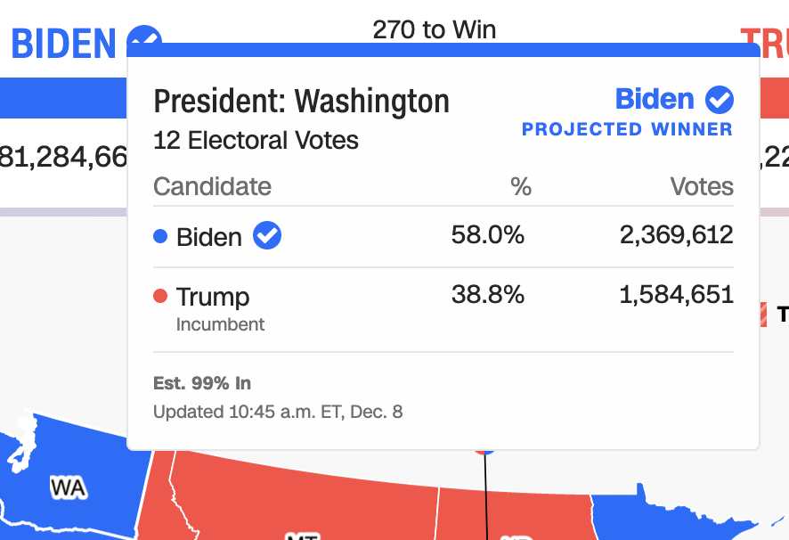
Operable Failures
54 - Interaction modality only has one input type
58 - No interaction cues or instructions
5 - Low contrast on interactive elements
4 - Keyboard focus indicator missing
4 - Complex actions have no alternative
18 - Target pointer interaction is too small
53

Slide 54


If a mouse can do something (like produce a tooltip), then there must be parity at least with a keyboard.
===
54

Slide 55
Operable Failures
54 - Interaction modality only has one input type
58 - No interaction cues or instructions
5 - Low contrast on interactive elements
4 - Keyboard focus indicator missing
4 - Complex actions have no alternative
18 - Target pointer interaction is too small
55

Slide 56
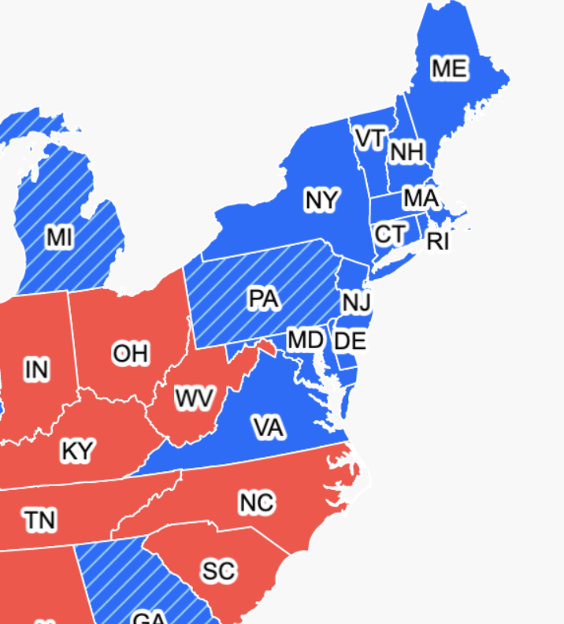

Expecting users to hover on something tiny is an accessibility design failure
56

Slide 57
Continue this for: Understandable,
Robust,
Compromising,
Assistive,
and Flexible
57

Slide 58
978 access failures found in ~60 minutes.
Robust:
275 - Does not conform to standards
82 - Semantically invalid
12 - Fragile technology support
Compromising:
54 - Information can only be reached through single process
61 - Information cannot be navigated according to narrative or structure
Assistive:
101 - Navigation and interaction is tedious
Flexible:
2 - User style change not respected
121 - User text adjustments are not respected
1 - Scrolling experiences cannot be adjusted or opted out of
Contrast and textures cannot be adjusted
Perceivable:
6 – Low contrast
57 - Content is only visual
50 - Color alone is used
3 - Meaningful elements can be distinguished
Operable:
54 - Interaction modality only has one input type
58 - No interaction cues or instructions
5 - Low contrast on interactive elements
4 - Keyboard focus indicator missing
4 - Complex actions have no alternative
18 - Target pointer interaction is too small
Understandable:
4 - Interactive context is not clear
6 - Metrics or variables are undefined
58
Notes:
Make sure to signal that this was from Chartability!!

Slide 59
Doing this work is hard.
59

Slide 60
Perceivable
Can someone perceive this in multiple ways? Is each way easy?

Slide 61
Perceivable Checklist:
High Contrast
CVD-Safe + Redundant Encoding
Alt Text

Slide 62
Design with high contrast
Colorblindness Disproportionately Overrepresented in A11y Resources
Colorblindness Disproportionately Overrepresented in A11y Resources
Colorblindness: % of People
Colorblindness: % of People
4%
4%
Low Vision: % of People
Low Vision: % of People
25%
25%
Colorblindness: # of Resources
Colorblindness: # of Resources
51
51
Low Vision: # of Resources
Low Vision: # of Resources
5
5
Notes:
https://projects.susielu.com/viz-palette

Slide 63
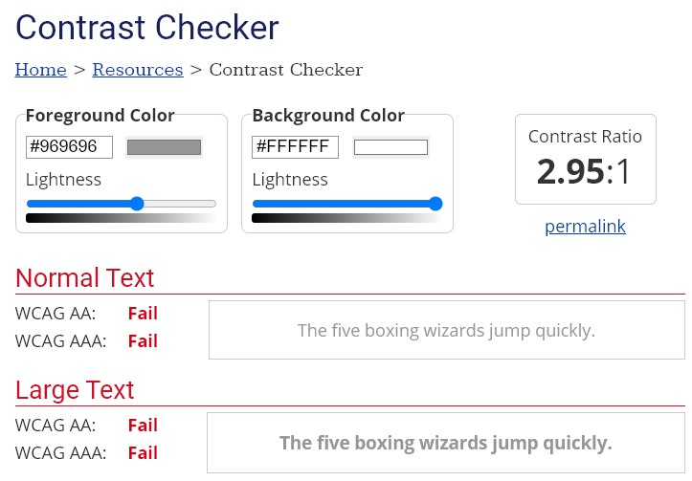
Use High Contrast Text
Text needs at least 4.5:1 contrast against its background.
Large text (bold and 16pt or larger) can be 3:1 or higher.

Slide 64
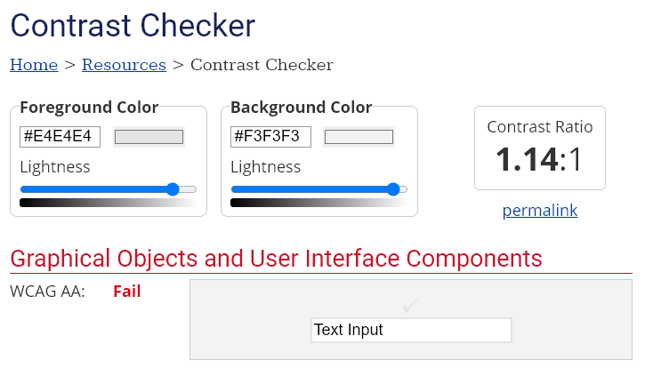
Use High Contrast Geometries
Chart elements need at least 3:1 contrast against their background.

Slide 65
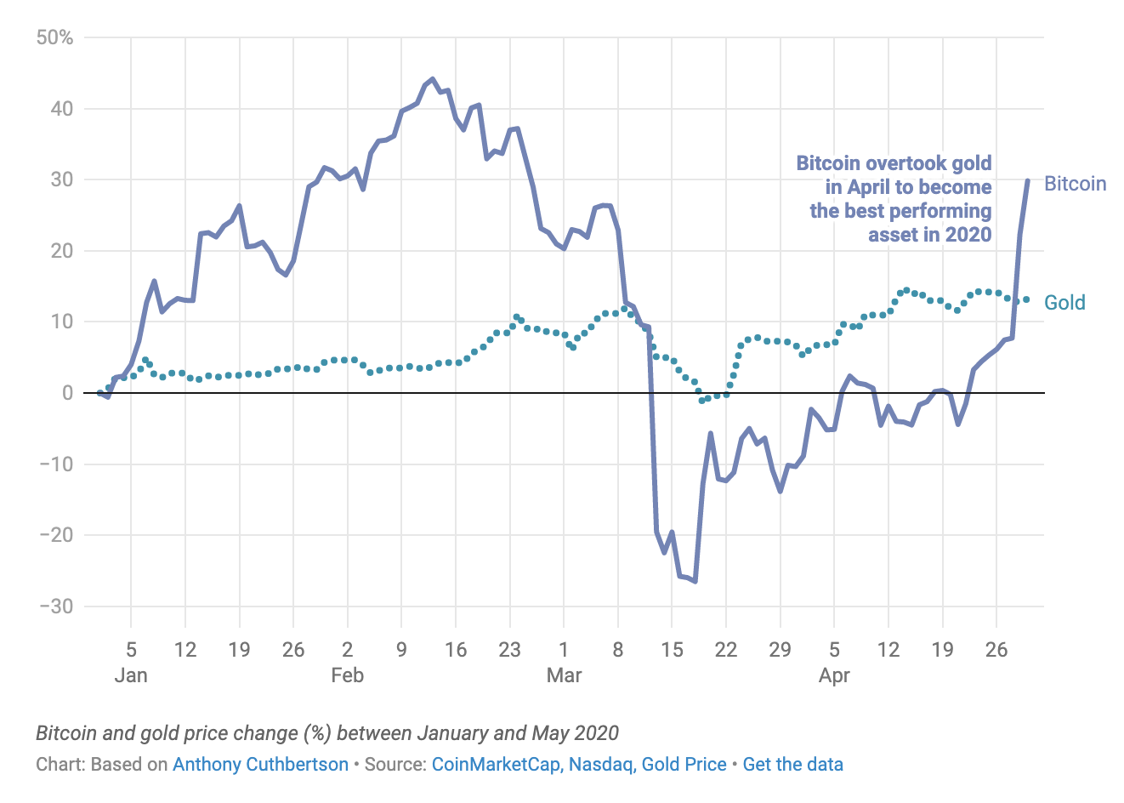
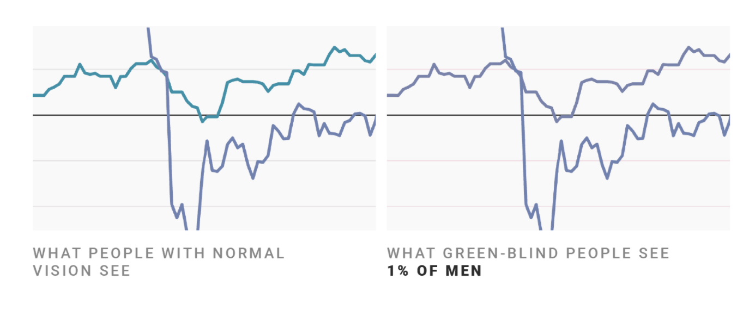
Don’t rely on color alone!
(Muth) https://blog.datawrapper.de/colorblindness-part2/

Slide 66
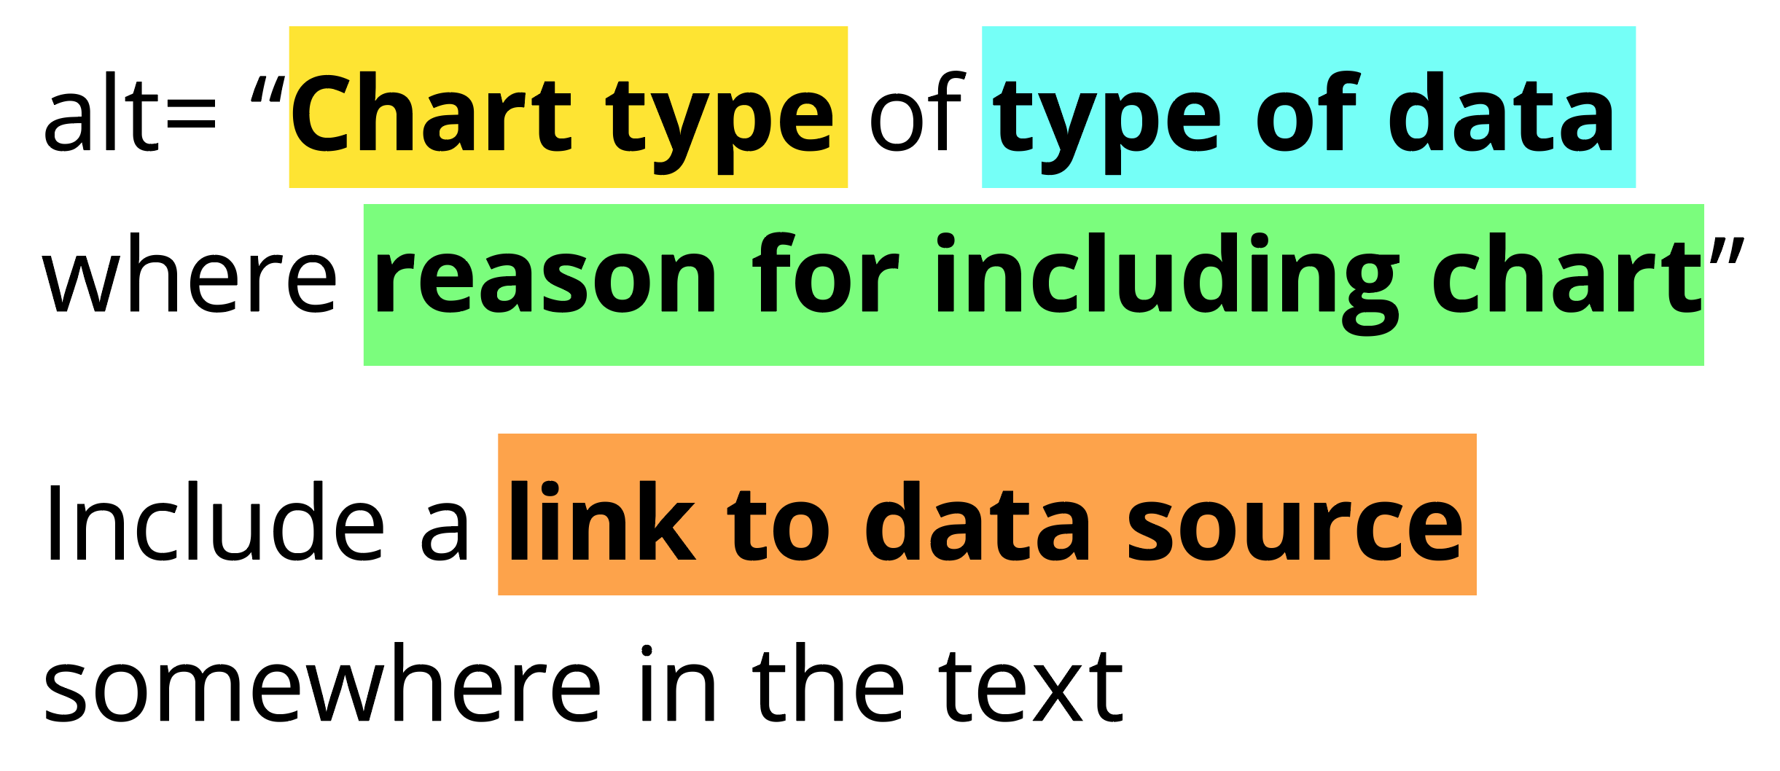
Add alt text
There is great research on alt text, but the most important thing to know is that you should add it to every image you post online (including twitter), in a document, or presentation.
Guidance: https://medium.com/nightingale/writing-alt-text-for-data-visualization-2a218ef43f81

Slide 67
Perceivable Evaluation Toolkit:
Contrast Checker
Safe color design
CVD Checker
Redundant encoding design ideas
Alt Text

Slide 68
Operable
Can someone operate this in multiple ways? Is each way easy?

Slide 69
Operable Checklist:
Mouse
Keyboard-only
Screen Reader

Slide 70
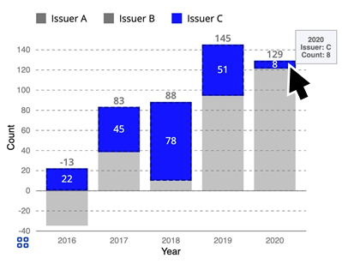
Ensure Keyboard Access (if interactive)

Slide 71
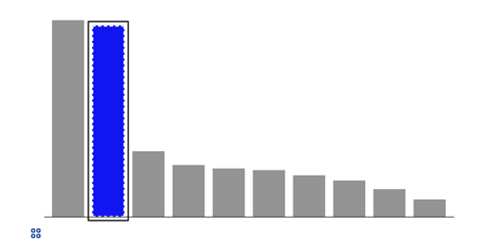
Indicate keyboard focus, use multi-modal style
This is a keyboard focus indicator (outer border) with the same styling effect applied on mouse hover (inner dashed white lines and blue fill)

Slide 72
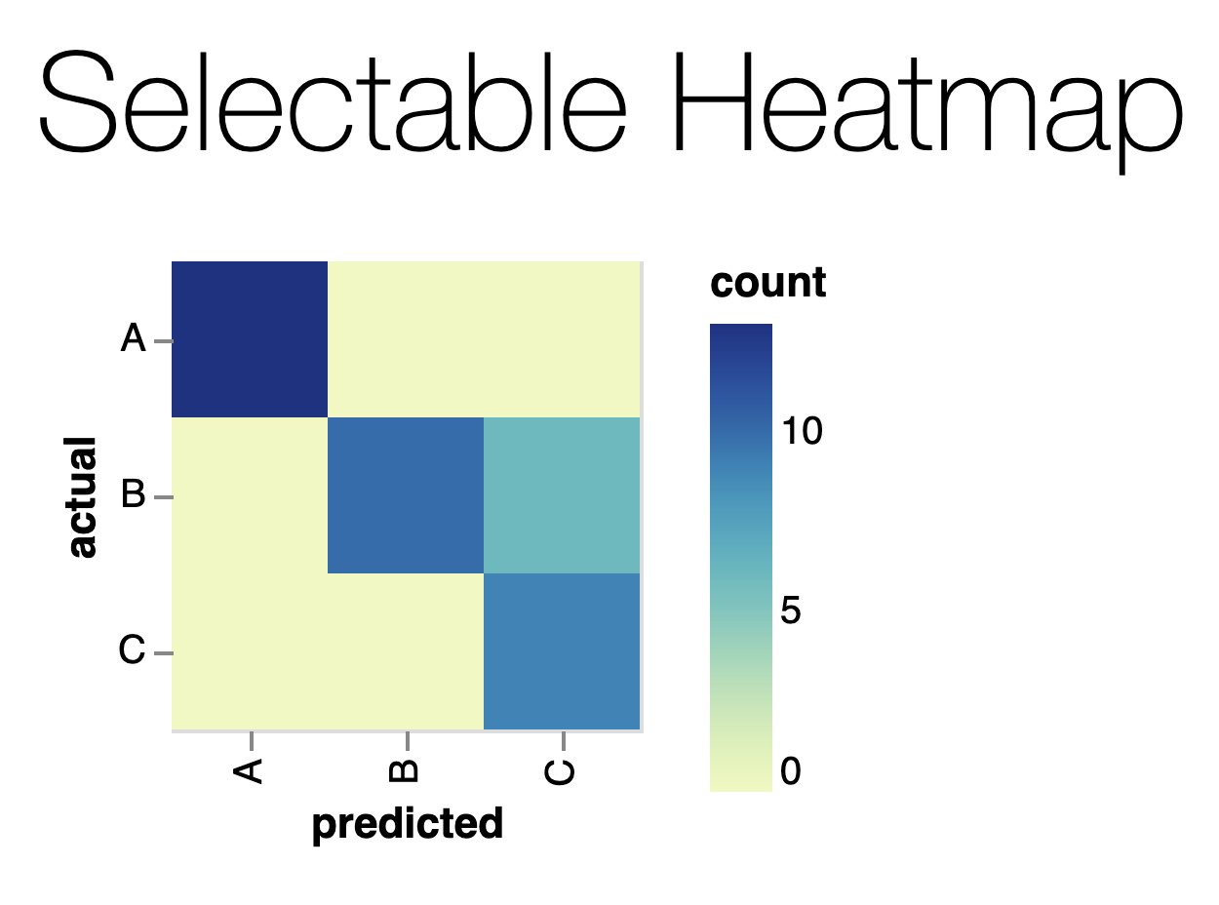
Why Keyboard-only?
Some things work for screen readers but not for keyboard-only users!
https://vega.github.io/vega-lite/examples/selection_heatmap.html

Slide 73
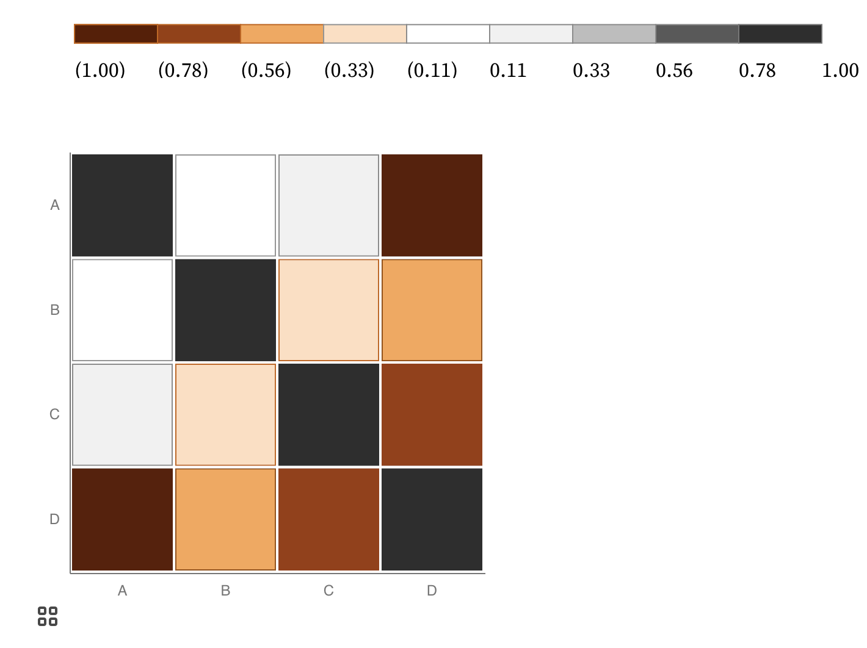
Keyboard only example:
https://observablehq.com/@frankelavsky/experimental-color-scale-textures

Slide 74
Operable Evaluation Toolkit:
Use your mouse: can it do something meaningful? (tooltip, click event, etc) If so:
Test using a keyboard-only: can you navigate and use keyboard activation (spacebar/enter) on the visualization?
Test using a screen reader: Can you use a screen reader to navigate and use keyboard activation on the visualization?

Slide 75
Understandable
Can someone understand this in multiple ways? Is each way easy?

Slide 76
Understandable Checklist:
Descriptive title, summary, or caption
Data table or data download
Reading level

Slide 77
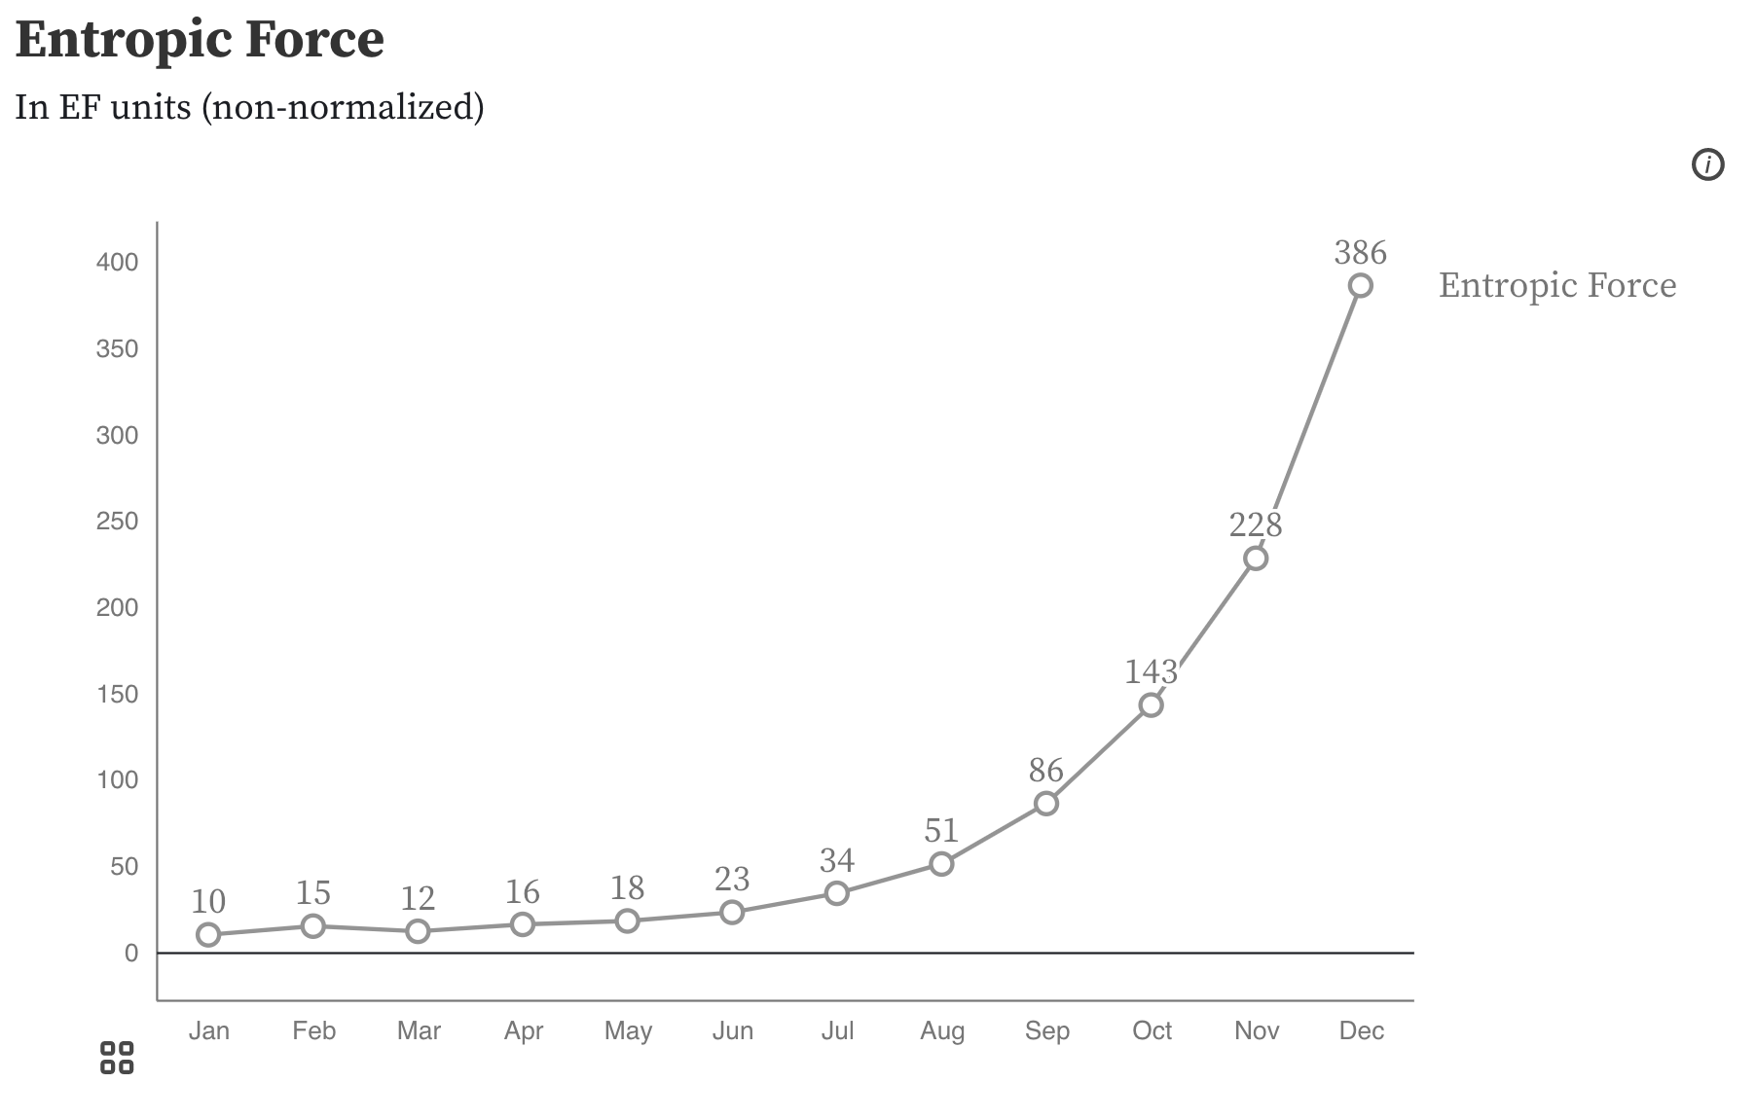
Non-descriptive titles are inaccessible

Slide 78
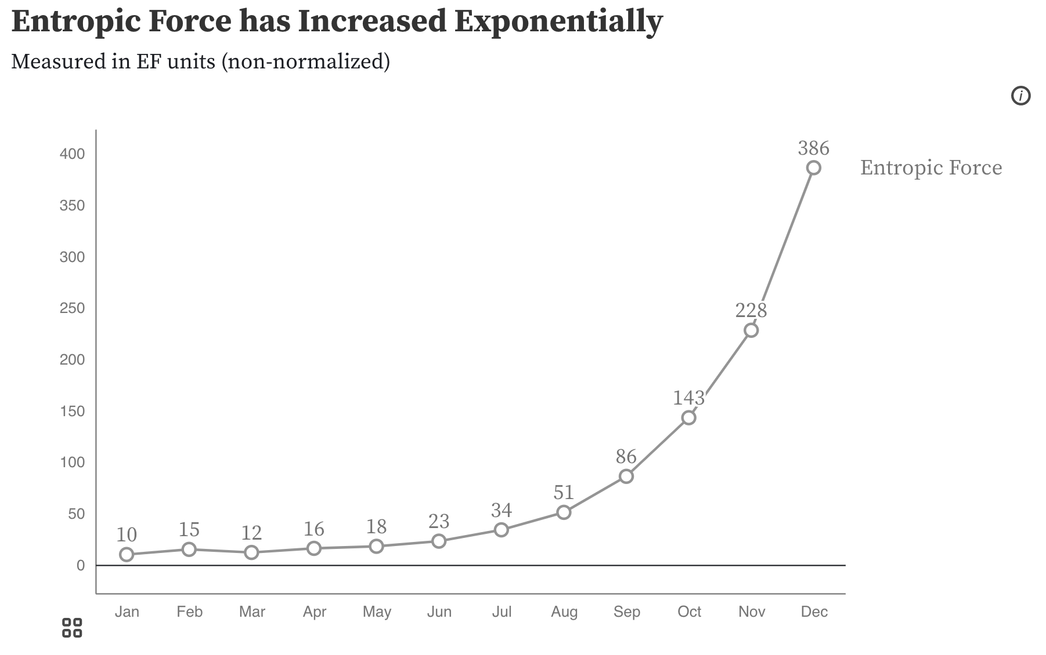
Descriptive titles have summaries/takeaways

Slide 79
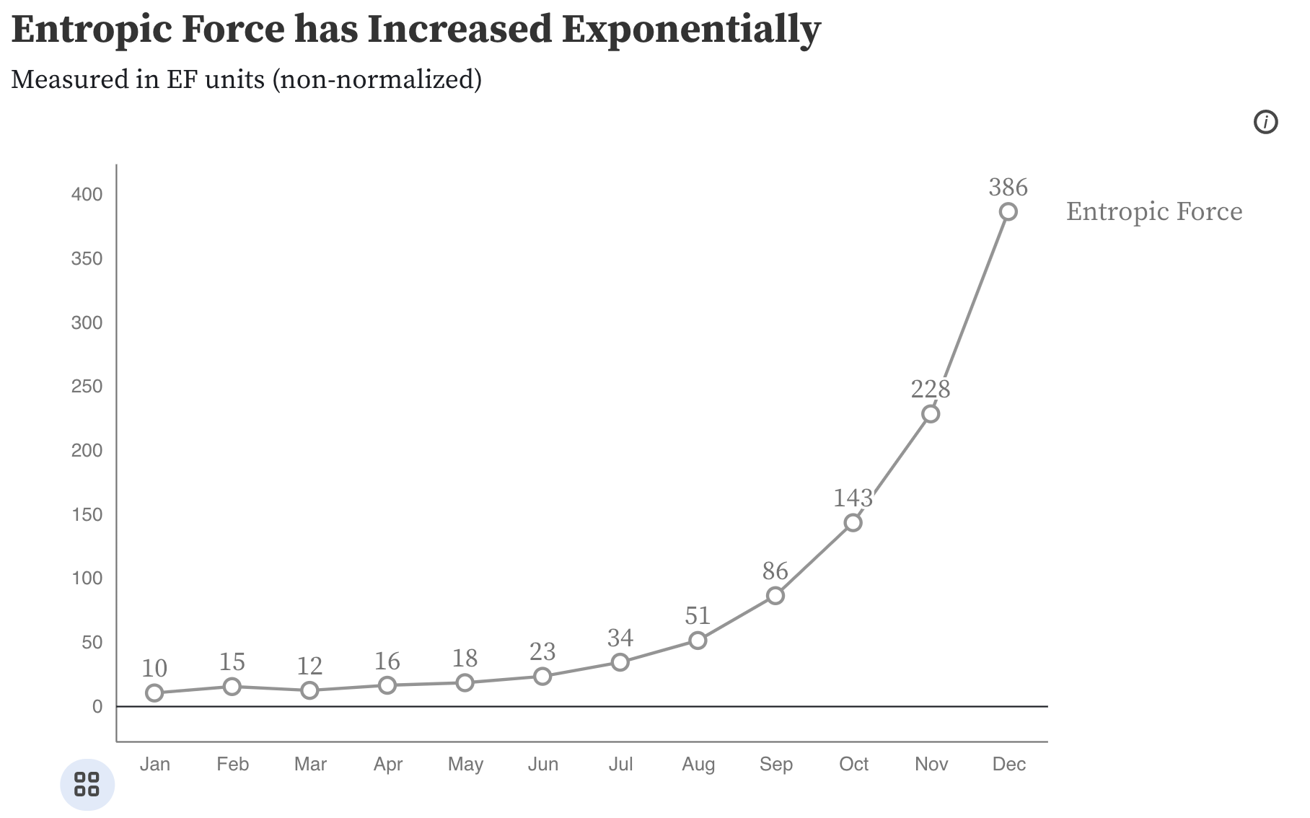
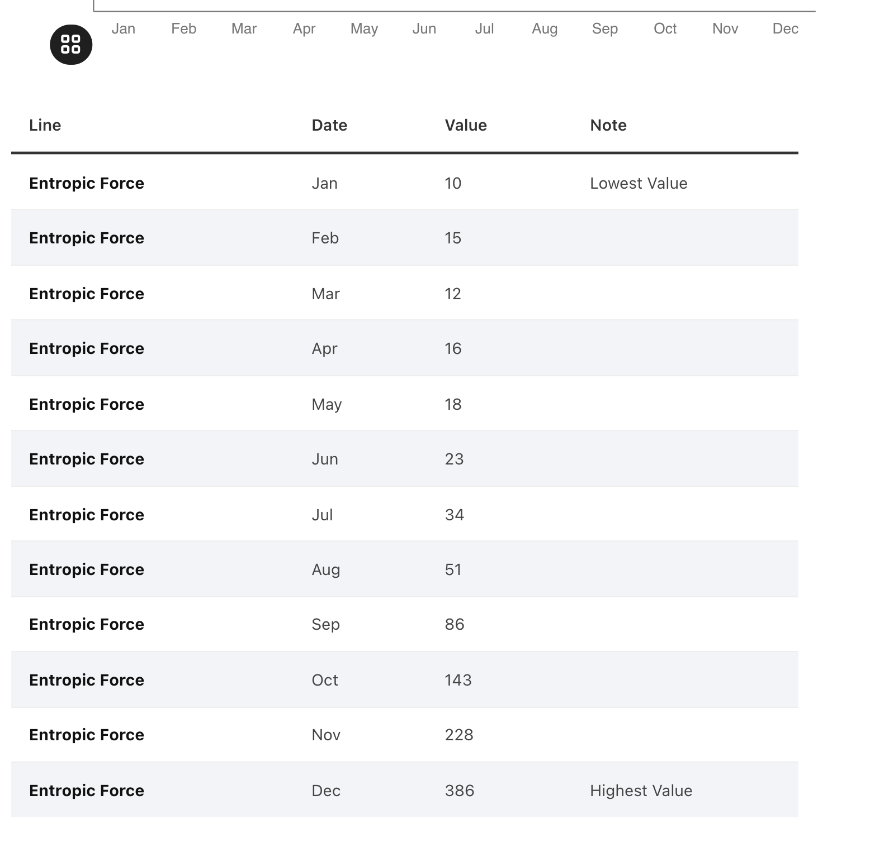
All charts should have data available!

Slide 80
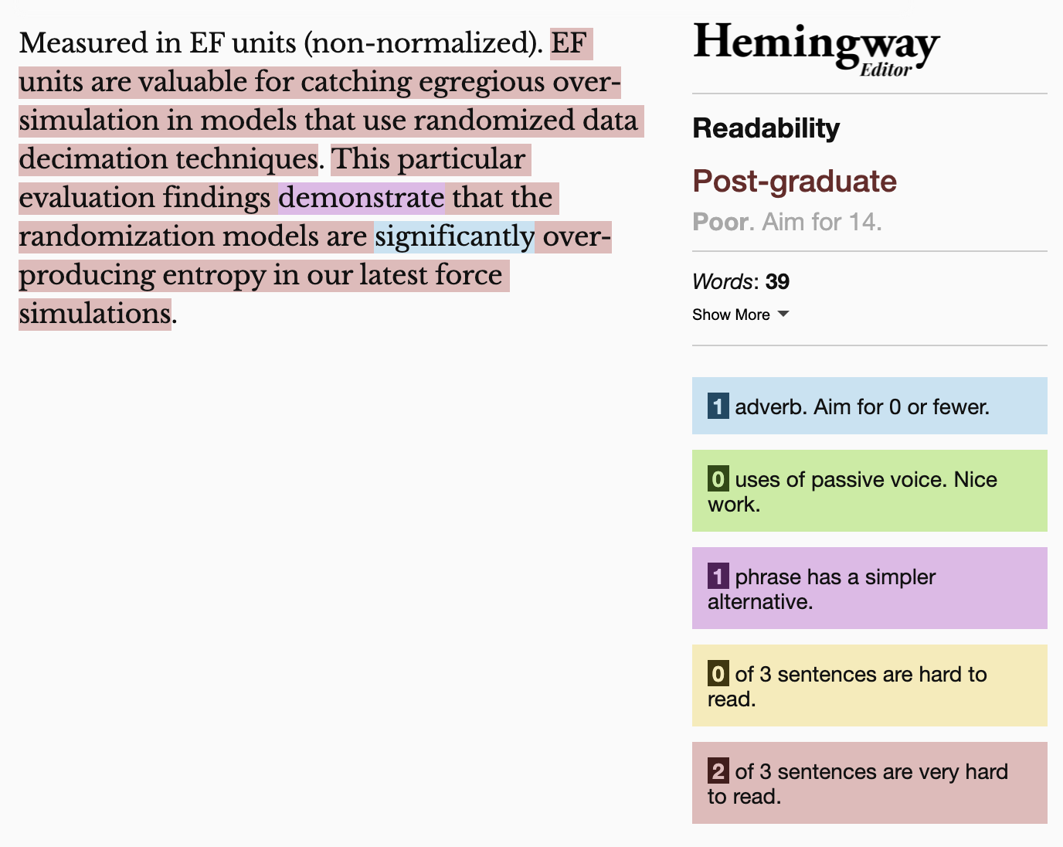
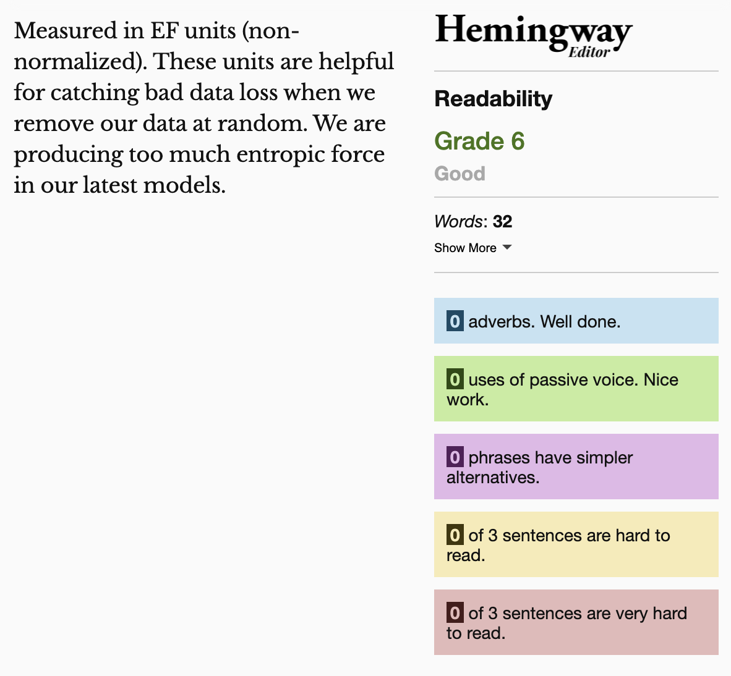
Keep summaries as non-technical as possible
If the topic is technical, provide a “plain language” summary somewhere close by that is easy to find (either in the same location or with by providing a link).

Slide 81
Understandable Evaluation Toolkit:
Is there a descriptive title, summary, or caption?
Is there an accessible table or downloadable data file provided?
Is the descriptive text supporting the visualization presented at a reading level at grade 9 or below?

Slide 82
Evaluation in the wild!
Does anyone have a visualization they have encountered lately (or made themselves) that they would like to audit together as a group?
Criteria:
The visualization isn’t static (it is interactive, has dynamic data, animations, or a combination of the 3)
It is publicly available (not behind a paywall)

Slide 83
Evaluation handbook:
(link to slides where we can all edit? Something else?)

Slide 84
Part 3: Hands-on making!
Let’s make some accessible data representations.

Slide 85
Accessible visualization
Examine your data
Sketch some ideas
Make a visual! (Excel, Figma, Illustrator, any tool that is fast and easy)
Share it
---
Tactile representation
Introduction
Group up!
Pick some materials
Co-craft tactile representations

Slide 86
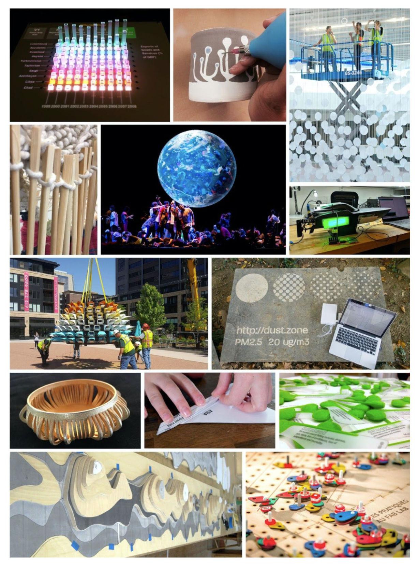
Making with Data

Slide 87
Dotpad,
braille embossers…

